Slide 1



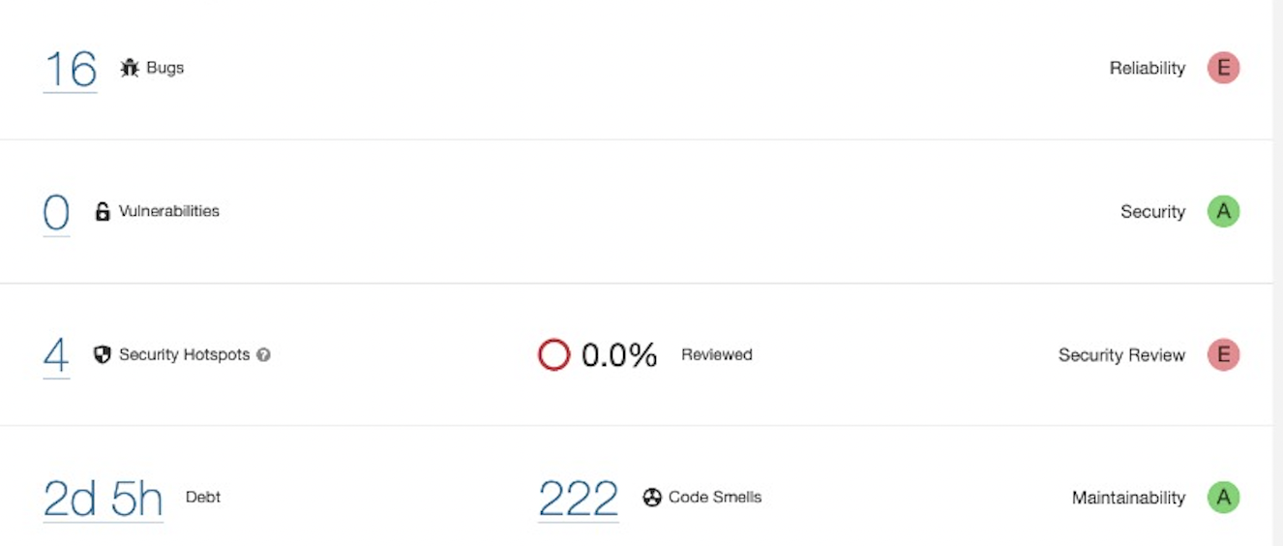
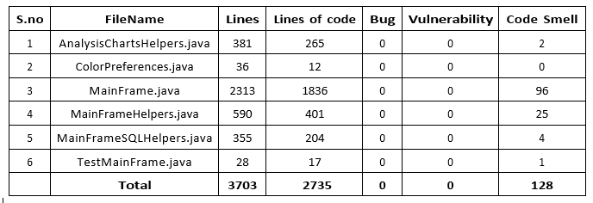
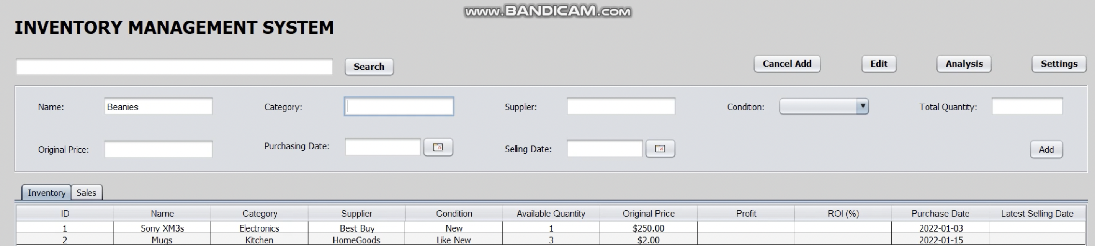
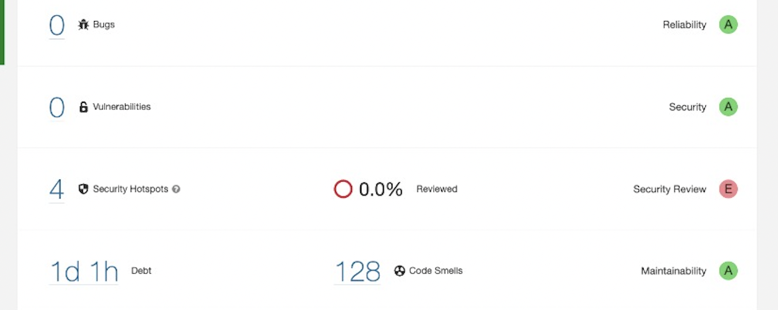

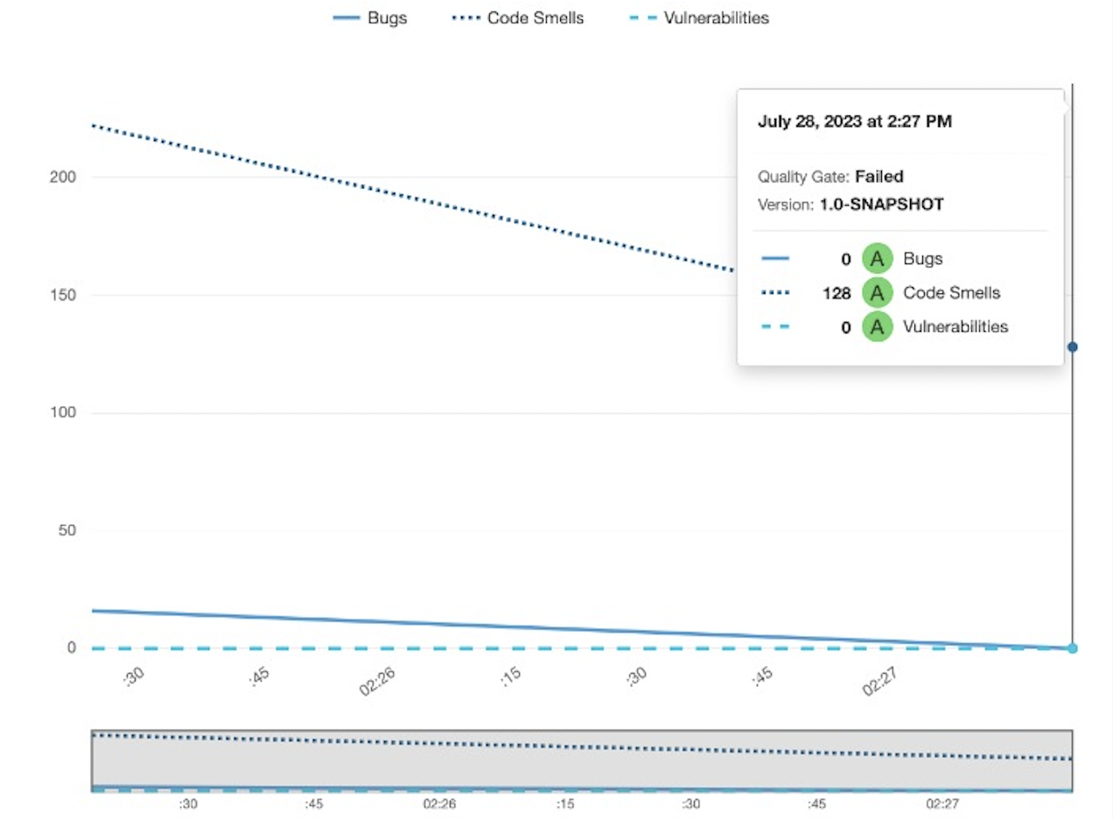



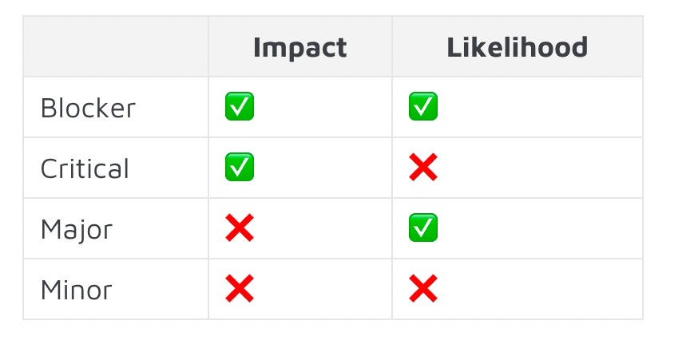


SOEN 6431 : SOFTWARE COMPREHENSION Pratik Gondaliya
AND MAINTENANCE Abhishek Gupta
Poojitha Bhupali
Sree Sneha Kothapalli
DÉJÀ VU
TEAM B
Collaboration Plan
Critical Decisions (cont.)
Lessons Learned
Outcomes of Refactoring
Design Thinking
Pair Programming
Environments Utilized:
GitHub : Source-code version control
Zoom: Team meetings
Google Docs: Documentation
Reengineering Strategies: Formulate solutions to improve maintainability.
Risk-Benefit Analysis: Assess risks and benefits of reengineering.
Collaboration: Effective teamwork demands open, respectful communication and idea sharing.
Communication Skills: Vital for project success, include regular meetings and clear expectations to prevent breakdowns.
Flexibility & Accountability: Adapting to changes and unforeseen issues. Each member responsible for task completion and project success.
Continuous Learning: Projects offer learning and improvement opportunities.
Before refactoring
Team Retrospective
User Interface of R
Increased Code Review Frequency: Enhance code quality, catch issues early.
Automated Testing Enhancements: Boost stability, improve quality.
Better Resource Allocation: Optimize outcomes, reduce delays.
Documentation and Knowledge Sharing.
After refactoring
Critical Decisions
Choice of Technology Stack: Critical decision impacting project efficiency and success.
User Interface Design: Crucial decision affecting user experience and engagement.
Maintainabilitay of the R
After refactoring
Limitations
By the ISO/IEC 25010 Standard
Modularity and Code Structure.
Clear Documentation and Comments.
Unit Testing and Quality Assurance.
Consistent Coding Standards.
Time and Resource.
Risk of Introduction of Bugs.
Lack of Comprehensive Test.
Legacy Code and Technical Debt.

